Slide 1
Home Doctor
Your doctor and pharmacy at your fingertips
Founder: Muhammad Qavi Shaikh

Slide 2
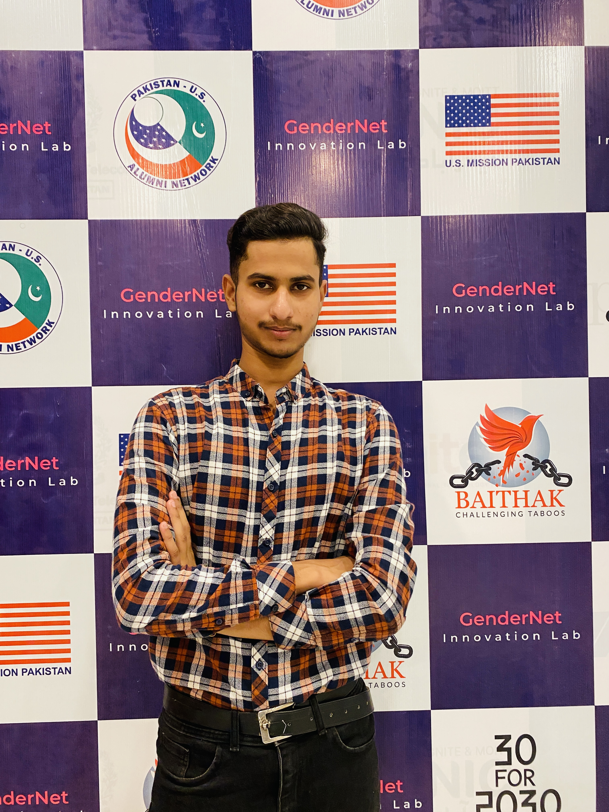
About Founder
My name is Muhammad Qavi Shaikh, and I am currently a third-year student at GC University. I specialize in MERN stack development and have previously interned as a web developer at Monitr and Indus tech startup through NIC. Before that, I secured the second position in an IT competition at my university, gaining recognition across the campus. Following my internship at NIC, where I witnessed the thriving startup environment, I contemplated starting my own startup. While I initially hesitated to pitch at NIC due to a lack of knowledge, I later participated in a Business Idea Award competition at my university. With my startup concept, Digital Web Creations, I emerged as the winner and received a generous cash prize. While my previous startup idea wasn't particularly innovative, my latest startup idea, which focuses on AI and innovative technologies, has allowed me to pitch at NIC. In addition to my entrepreneurial pursuits, I also engage in freelancing and teaching in the field of web development. I have actively participated in various NIC programs and recently attended Career Connect in Karachi, where I gained valuable insights into startups and entrepreneurship.
Founder: Muhammad Qavi Shaikh
Contact No: 0313-3825456
Email: qavi.shaikh11@gmail.com
LinkedIn: Qavi Shaikh

Slide 3
MY STARTUP STORY
Once, while chatting with a friend at the medical store next to the hospital, I noticed a group of women rushing in. They complained of severe headaches and high fevers, pleading with the pharmacist for something to ease their discomfort. The pharmacist quickly handed them over-the-counter medication, offering temporary relief until they could see a doctor.
The next day, I found myself back at the medical store, and to my surprise, I witnessed a similar scene unfold. Different people, same rush, same urgency. It struck me then — why not create an application where individuals could order medication from the comfort of their homes, and even receive guidance on which tablets to take for common ailments like headaches and fevers.
That moment of realization sparked an idea within me. I envisioned an app that would revolutionize the way people accessed healthcare, especially for minor ailments. With just a few taps on their phones, they could order the medication they needed, without the hassle of visiting a pharmacy or waiting for a doctor's appointment.

Slide 4
PROBLEM STATEMENT
The overarching challenge lies in the prevalence of low health literacy and limited medical knowledge within our society, particularly among the less educated individuals. Many people lack the necessary understanding of medical concepts and treatments, which hampers their ability to make informed healthcare decisions.
The problem lies in the inconvenience and inefficiency of current healthcare systems, particularly when it comes to accessing medication for common ailments. Many individuals face hurdles in obtaining timely relief for minor health issues like headaches and fevers, especially when they cannot immediately consult a doctor.

Slide 5
SOLUTION STATEMENT
We are developing a comprehensive healthcare solution consisting of a web application and a mobile application integrated with an AI-powered chatbot. This platform will revolutionize the way individuals access medical advice and medication by providing convenient, accessible, and personalized healthcare services.
Through our web and mobile applications, users will be able to describe their symptoms and medical conditions to the AI chatbot, which will leverage natural language processing (NLP) algorithms to understand their needs accurately. Based on this information, the AI chatbot will recommend appropriate tablets and treatments tailored to each user's specific condition.
One of the key features of our solution is the ability for users to order recommended medication directly from our website or mobile application. This streamlined process eliminates the need for multiple trips to a pharmacy and ensures that users have quick access to the medication they need from the comfort of their own homes.

Slide 6
I don’t find any competitive in this type of application in Pakistan
COMPETITIVE EDGE / USP

Slide 7
Thank You ☺

